Slide 1
HAWKES LEARNING
Applying MLA Styles and Formatting

Slide 2
Ways to Integrate Sources
Summaries
Paraphrases
Quotations
HAWKES LEARNING

Slide 3
Citing Sources
Within the text
List of Works Cited
HAWKES LEARNING

Slide 4
Signal Phrase
Present source information in sentence form
HAWKES LEARNING

Slide 5
Signal Phrase
Present source information in sentence form
“According to ‘Age-Targeted Marketing,’ Billow writes…”
HAWKES LEARNING

Slide 6
Signal Phrase
Present source information in sentence form
“According to ‘Age-Targeted Marketing,’ Billow writes…”
HAWKES LEARNING

Slide 7
In-text Citations
Exactly where information is found
HAWKES LEARNING

Slide 8
In-text Citations
Exactly where information is found
(Brady 122–131)
Author-page
(Green 79)
HAWKES LEARNING

Slide 9
Works Cited
Located at the end of the paper and should be _______________.
titled
alphabetized
formatted
HAWKES LEARNING

Slide 10
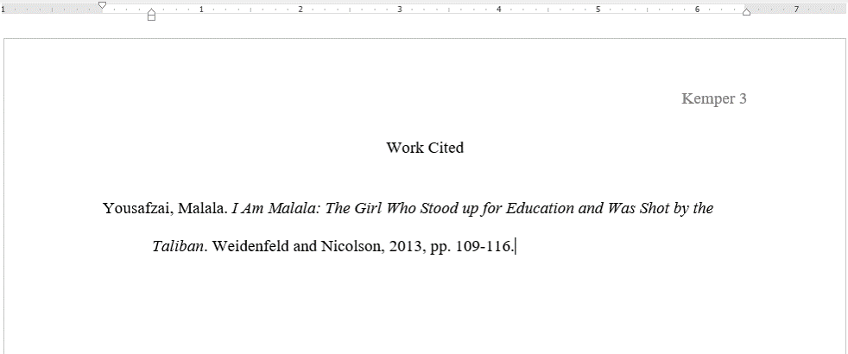
Works Cited
HAWKES LEARNING

Slide 11
Works Cited
Double space
HAWKES LEARNING

Slide 12
Works Cited
1”
Indent ½”
HAWKES LEARNING

Slide 13
Works Cited
HAWKES LEARNING

Slide 14
Works Cited
HAWKES LEARNING

Slide 15
Works Cited
HAWKES LEARNING

Slide 16
Works Cited
HAWKES LEARNING

Slide 17
Works Cited
HAWKES LEARNING

Slide 18
Summary
Large amount of information in a few sentences
broad overview
HAWKES LEARNING

Slide 19
Summary
Written in own words
Borrowed ideas
Must cite
→
→
HAWKES LEARNING

Slide 20
Paraphrase
→
More in depth than a summary
→
Refer to something specific
HAWKES LEARNING

Slide 21
To Avoid Plagiarism
Change
&
sentence structure
words
HAWKES LEARNING

Slide 22
Paraphrase Example
Original Source
Paraphrase
Marketing companies usually target children around the age when they begin to have influence over their peers in order to reach more of the same demographic.
Advertisements are geared towards kids old enough to utilize peer pressure. That way they have access to a larger spectrum of consumers.
→
HAWKES LEARNING

Slide 23
Quotations
Direct words of the source
Only used when author’s words are powerful and unique
HAWKES LEARNING

Slide 24
Quotations
Quotation Marks
Signal Phrase
In-Text Citations
Quote
HAWKES LEARNING

Slide 25
Example
Quotation with signal phrase and in-text citation:
In The Catcher and the Rye, Holden says, “I’m quite illiterate, but I read a lot” (Salinger 18).
HAWKES LEARNING

Slide 26
Integrating Sources
Summaries
Paraphrases
Quotations
HAWKES LEARNING

Slide 27




HAWKES LEARNING

